Slide 1
Perkins V: Adding Value to Student Success

Slide 2
Contents
What is Perkins V?
Goal & Objectives of the Perkins Grant
Louisiana Career Clusters
Perkins-approved clusters at Delgado Community College
Updated equipment in student success
Career Navigators in student success

Slide 3
What is Perkins V?
Strengthening Career and Technical Education
For The 21st Century Act (Perkins V)
The Perkins Act
The Carl D. Perkins Career and Technical Education Act of 2006 (Perkins IV) is a principal source of federal funding to states and discretionary grantees for the improvement of secondary and postsecondary career and technical education programs across the nation. The purpose of the Act is to develop more fully the academic, career, and technical skills, of secondary and postsecondary students who elect to enroll in career and technical education programs.

Slide 4
Goals and Objectives of the Perkins Grant
The goal of Perkins is to improve the quality of CTE (Career and Technical Education) programs
Offer enhanced flexibility of spending via the targeting of special populations
Prepare CTE students for high-skill, high-wage, or high-demand occupations
Promote evaluation of performance, (both colleges and districts,) of CTE students with respect to State-determined levels of performance
Increase participation of state and local business leaders to collaborate with secondary and post-secondary institutions
Provide technical assistance that promotes leadership, initial preparation, and professional development, as well as to improve the quality of CTE teachers, faculty, administrators, counselors, and advisors
Support and build partnerships between business, industry, and education stakeholders
Define and implement career pathways into curriculum and job exploration platforms

Slide 5
Perkins IV to V: Major Changes
Evaluation of student performance on accountability measures
• How the offered programs are of sufficient size, scope, and quality, to meet the needs of students
• How the offered programs are aligned to labor market information and demand
• Progress towards implementation of programs of study
• How the recipient will improve recruitment, retention, and training, of CTE personnel
• Progress towards equitable access, including:
1. addressing barriers special populations face to access and performance,
2. providing programs designed to enable special populations to meet accountability measures;
3. providing activities to prepare special populations for high-skill, high-wage, or in demand jobs, leading to self-sufficiency.
Funding:
Can fund programs down to 5th grade (vs. 7th grade under Perkins IV)

Slide 6
Reportable Student Subgroups “Special Populations”
 | Perkins IV | Perkins V
Individuals with Disabilities | Y | Y
English Learners | Y | Y
Economically Disadvantaged | Y | Y
Military Connected |  | Y
Foster Care |  | Y
Homeless | Y | Y
Migrant | Y | Y
Single Parents | Y | Y
Out-of-Workforce Individuals | Y | Y

Slide 7
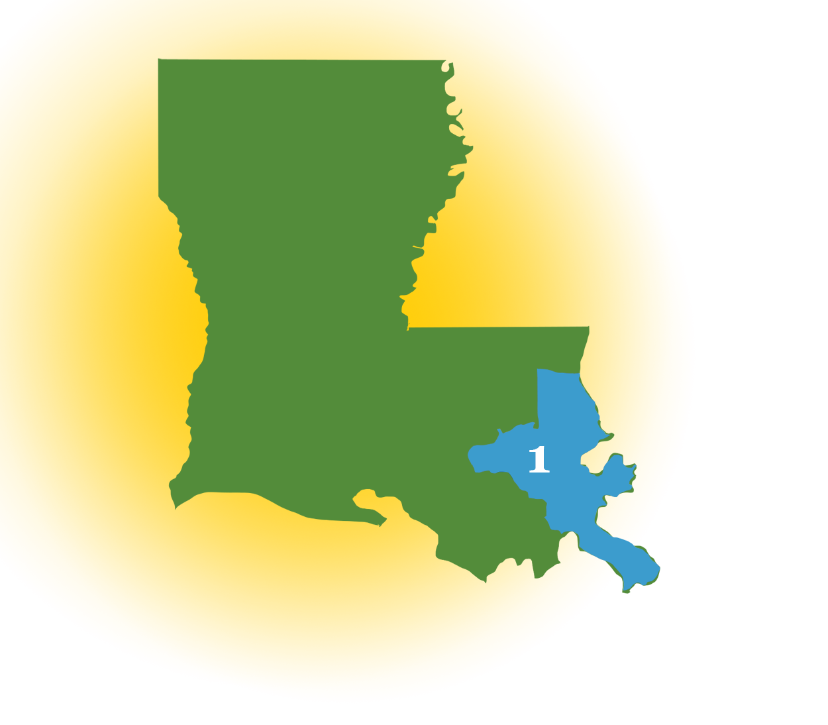
Louisiana Region 1 Partnerships
Delgado’s region (Region 1) is in partnership with
Post-secondary
Nunez Community College,
Northshore Technical Community College
Charter and Secondary Schools
Orleans Parish
Jefferson Parish
St. Bernard Parish
St. Charles Parish
St. James Parish
St. John Parish
St. Tammany Parish
Plaquemines Parish

Slide 8
Perkins-Approved Programs of Study at Delgado Community College
Health Sciences Skilled Crafts Information Technology
ASN Nursing Electrical Computer and Electronic Service Tech.
Practical Nursing HVAC Computer Information Technology
Physical Therapy Asst. Residential Const. Computer Network Technology
Medical Coding Welding Computer Network Technician
Occupational Therapy Asst. Electronics Service Technology
Medical Laboratory Tech. Instrumentation and Control
Respiratory Care Tech. Web Site Design
E R Medical Tech./Paramedic
Radiologic Tech.
Massage Therapy
Surgical Tech.

Slide 9
How current equipment helps student success
Perkins V funding seeks to give students the best opportunity for workplace success in high-skill, high-wage, in-demand, or emerging occupations.
The purpose of equipment in a classroom settings is to:
familiarize students with state of the art equipment currently used in industry
teach students to demonstrate a positive attitude
work in a team environment
assume personal responsibility in order for students to utilize essential employability skills in the workplace

Slide 10
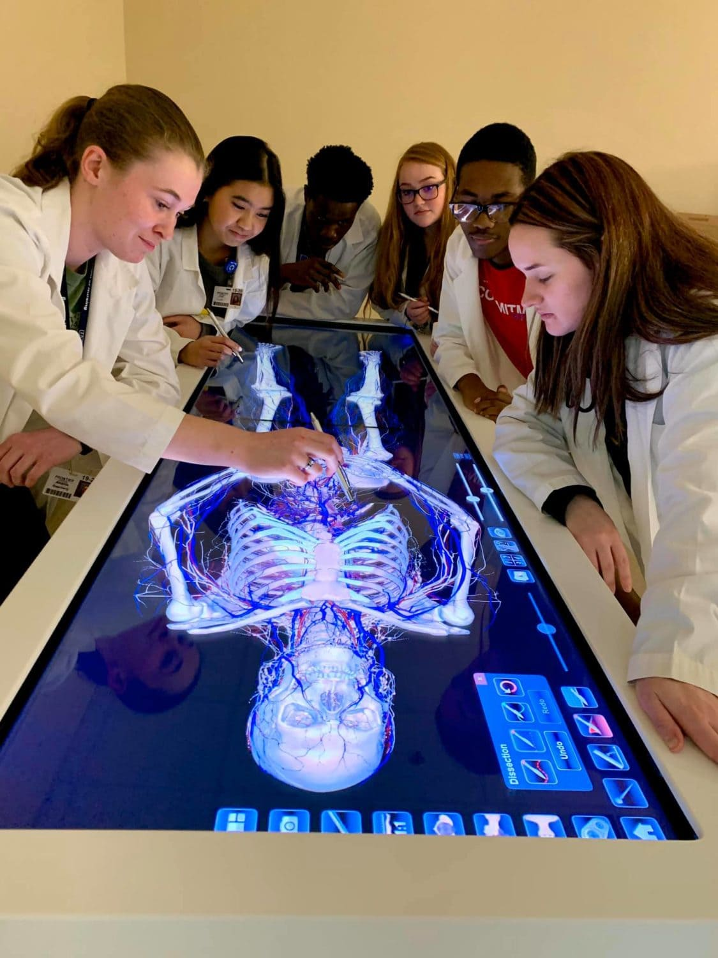
The Anatomage
Table 7
Provided by Perkins funding
for the Radiologic Technology
Program of Study

Slide 11
Anatomage Table function …

Slide 12
Radiologic Technology Program Effectiveness
Job Placement Rate (JPR)
YEAR OF GRADUATION | NUMBER OF GRADUATES SEEKING EMPLOYMENT WITHIN 12 MONTHS OF GRADUATION | NUMBER OF GRADUATES EMPLOYED WITHIN 12 MONTHS OF GRADUATION | JPR%
2020 | 30 | 28 | 93.3%
2019 | 34 | 33 | 97%
2018 | 28 | 27 | 96.4%
2017 | 24 | 24 | 100%
2016 | 30 | 27 | 90%
Five Year Average | 146 | 139 | 95.2%

Slide 13
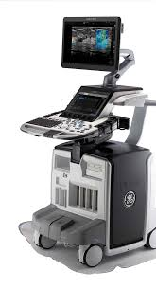
GE Logiq E10
Provided by Perkins funding for the Diagnostic Medical Sonography Program of Study

Slide 14
GE Logiq E10 function …

Slide 15
Diagnostic Medical Sonography Program Effectiveness
Job Placement Rate (JPR) & Program Completion Rate (PCR)
YEAR | JOB PLACEMENT RATE | PROGRAM COMPLETION RATE
2017-2018 | 100% | 92% (11/12)
2016-2017 | 100% | 83% (10/12)
2015-2016 | 100% | 92% (11/12)
2014-2015 | 92% | 100% (12/12)
2013-2014 | 100% | 92% (11/12)
5 Year Average (2014-2018) | 98.4% | 91.8%

Slide 16
Career Navigators …
By definition:
Develop relationships with prospective employers
Coach, mentor, supervise, and motivate students
Direct students to mesh academic learning with industry-based employability skills
Guide students to above average organizational and office skills, self-directed management, and productive team environments
Create career pipelines to local/regional organizations for students/graduates

Slide 17
Career Navigators
Teach workplace compliance
Conduct individual and group workshops
Assist students in creation of career planning
Evaluate progress of student career development

Slide 18
Rachel Wilkerson Nursing Navigator

Slide 19
Nursing Navigator duties include:
Acts as liaison for single moms majoring in Nursing to improve attainment rates of degrees or high credentials.
Provides case management support and career exploration, which leads to career pathways and professional development.
Maintains cooperative working relationships with agencies and organizations interested in public healthcare to provide employment lead for nursing students.
Attends numerous college fairs to recruit students and create partnerships between local high schools.
Engages potential employers by attending local job fairs.
Schedules and host information sessions.

Slide 20
Monecia Moody Skilled Crafts Navigator

Slide 21
The Skilled Crafts Navigator’s duties include:
Acts as Academic Advisor of Technical Programs to assist students through their journey of earning a certification or a technical diploma
Serves as liaison between faculty, staff, and students to help resolve academic issues
Participates in Delgado's RIGHT PATH Initiative with other Academic Advisors as a part of the Quality Enhancement Plan to help increase student retention
Works closely with departments in, and related to, Student Affairs to gather and disseminate information to students or in directing them to the appropriate department
Builds strong relationships with students that will guide them on the proper path to ensure that each and every participant is a completer

Slide 22
Arthur Williamson: Information Technology Navigator

Slide 23
Information Technology Navigator duties include:
• Assists students with creating and updating their LinkedIn pages to assist with networking and job searching
• Provides career navigation to students to help them understand their specific path to employment
• Creates a, “pipeline," relationship between our students and local tech employers that are hiring
• Compiles a database of over 25 vendors that provide services ranging from guest speaking to career placement
• Assists in with employer expo each semester to directly match our students with vendors
• Makes connections that lead to internship opportunities for our students
• Creates a weekly newsletter for students that highlights important industry information and trends
• Facilitates alumni engagement events and correspondence

Slide 24
Resources

Slide 25
Perkins Impact
Graduates
Fall 2017 – Fall 2020
Cluster 1: Health Sciences | 2736
Cluster 2: Skilled Crafts | 648
Cluster 3: Information Technology | 380
Total | 3764

Slide 26
Questions? Contact us …
Kathy Weaver kweave@dcc.edu Grant Manager
Anna Runez arunez@dcc.edu Asst. Coordinator
Warren Atkins, Jr. Watkin@dcc.edu Career Pathways Coord.
Kendra Newton knewto@dcc.edu Technical Field Coord.
Violet Smith vsmith1@dcc.edu Technical Assistant

